Slide 1
How the web works?
Some basic concepts you need to know
Notes:
This slide contains concepts so lecturer ask students to discuss the the related problems for excercise

Slide 2
Summary
Definitions and History
The Client-Server Model
Where is the Internet?
Internet Protocols
Domain Name System
Uniform Resource Locators
Hypertext Transfer Protocol
Web server
Tools and Technologies to create Web Application

Slide 3
Definitions and History

Slide 4
Definitions and History
Telephone Network
Packet Networks
ARPANET (1969)
X.25 (1974)
USENET (1979)
TCP/IP (1983) ← INTERNET

Slide 5
Definitions and History
The Internet and WWW are different (but related) things

Slide 6
Definitions and History
URLS
HTTP
SERVERS
BROWSERS
HTML

Slide 7
Definitions and History
The Growth of the Internet

Slide 8
Definitions and History
Advantages:
Accessible from any Internet-enabled computer.
Usable with different operating systems and browser applications.
Easier to roll out program updates
Fewer security concerns about local storage.

Slide 9
Definitions and History
Disadvantages:
Requirement to have an active Internet connection
Security concerns about sensitive private data being transmitted over the Internet.
Concerns over the storage, licensing, and use of uploaded data.
Problems with certain websites not having an identical appearance across all browsers.
Restrictions on access to operating system resources
Clients or their IT staff may have additional plugins added to their browsers

Slide 10
Definitions and History

Slide 11
Definitions and History

Slide 12
Definitions and History

Slide 13
The Client-Server Model

Slide 14
The Client-Server Model
The Peer-to-Peer Alternative

Slide 15
The Client-Server Model
The Request-Response Loop

Slide 16
The Client-Server Model
Server Types
Web Servers
Application Servers
Database Servers
Mail Servers
Media Servers
Authentication Servers
…

Slide 17
The Client-Server Model
Real-World Server Installations – Server Farm

Slide 18
The Client-Server Model
Real-World Server Installations – Server Rack

Slide 19
The Client-Server Model
Real-World Server Installations – Data Center

Slide 20
Where is the Internet?

Slide 21
Where Is the Internet?
From the Computer to the Local Provider

Slide 22
Where Is the Internet?
(Simplified) Routing Tables

Slide 23
Where Is the Internet?
From the Local Provider to the Ocean’s Edge

Slide 24
Where Is the Internet?
From the Local Provider to the Ocean’s Edge –IXP and Data Centers

Slide 25
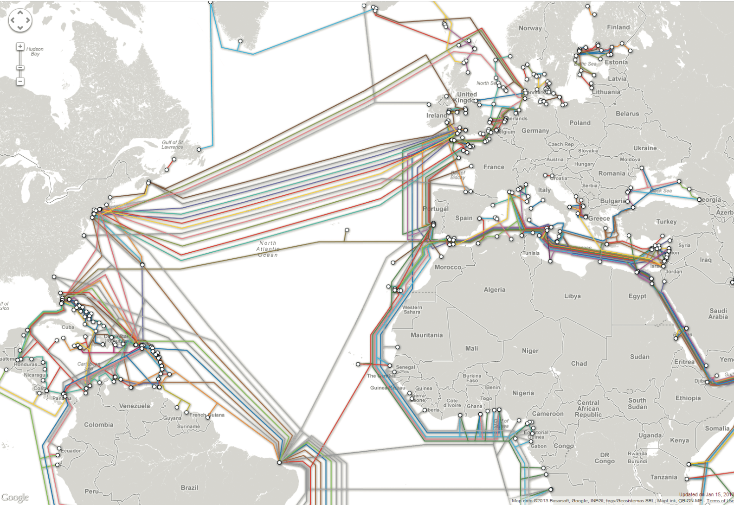
Where Is the Internet?
Across the Oceans

Slide 26
Internet Protocols

Slide 27
A Layered Architecture
TCP/IP.
These protocols have been implemented in every operating system, and make fast web development possible.
Networking is it’s own entire discipline.
Web developer needs general awareness of what the suite of Internet protocols does

Slide 28
A Layered Architecture

Slide 29
Link Layer
Responsible for
physical transmission of data across media (both wired and wireless) and
Establishing logical links.
It handles issues like packet creation, transmission, reception, error detection, collisions, line sharing, and more.
Much more to learn in Networking courses outside of web development.

Slide 30
Internet Layer
The Internet layer provides “best effort” communication.
Makes use of IP addresses

Slide 31
Internet Layer (IP)

Slide 32
IP addresses

Slide 33
Transport Layer (TCP)
Ensures transmissions arrive in order and without error

Slide 34
Application Layer
There are many application layer protocols. Web developers should be aware of :
HTTP. The Hypertext Transfer Protocol is used for web communication.
SSH. The Secure Shell Protocol allows remote command-line connections to servers.
FTP. The File Transfer Protocol is used for transferring files between computers.
POP/IMAP/SMTP. Email-related protocols for transferring and storing email.
DNS. The Domain Name System protocol used for resolving domain names to IP addresses.

Slide 35
Domain Name System

Slide 36
Name Levels

Slide 37
Types of Top Level Domains
Generic top-level domain (gTLD)
Unrestricted. TLDs include .com, .net, .org, and .info.
Sponsored. TLDs including .gov, .mil, .edu, and others.
New TLDs.
Country code top-level domain (ccTLD)
TLDs include .us , .ca , .uk , and .au.
Internationalized Domain Names
arpa

Slide 38
Name Registration

Slide 39
Facts about DNS
DNS translates a hostname to an IP address.
The DNS hierarchy is made up of the following components:
(dot) domain (also called the root domain)
Top Level Domains (TLDs) (.com, .edu, .gov)
Domains
Hosts
A fully qualified domain name (FQDN) must include the name of the host and the domain, not just the domain.
A forward lookup uses the host name (or the FQDN) to find the IP address.
A reverse lookup uses the IP address to find host name (or FQDN).

Slide 40
DNS name resolution process
When a DNS name resolution request is forwarded to a DNS server, the DNS server examines its local DNS cache for the IP address.
If the IP address is not in the DNS servers cache, it checks its Hosts file. (Since the Hosts file is a static text file, it is not commonly used.)
If the DNS server is not authoritative and configured for forwarding, the DNS server forwards the request to a higher-level DNS server.
If the DNS server cannot forward the request, or if forwarding fails, the DNS server uses its Root Hints file (also known as Cache.dns). The Root Hints file lists the 13 root DNS servers.
The root DNS server responds with the address of a com, edu, net, or other DNS server type (depending on the request).
The DNS server forwards the request to the high-level DNS server, which can respond with a variety of IP addresses

Slide 41
DNS name resolution process
A DNS server can forward a DNS request to an upstream DNS server if it cannot resolve a host name to an IP address.
An authoritative server is a DNS server that has a full, complete copy of all the records for a particular domain.
A caching-only DNS server has no zone information; it is not authoritative for any domains.
The Root Hints file (also called the Cache.DNS file) lists the 13 root DNS servers. A DNS server uses the Root Hints file to forward a request to a Root DNS server as a last resort to resolve a host name to an IP address.
A Root DNS server refers DNS servers to .com or .edu or .gov level DNS servers.
Many DNS servers will perform recursion.
Recursion is the process by which a DNS server or host uses root name servers and subsequent servers to perform name resolution.
Most client computers do not perform recursion, rather they submit a DNS request to the DNS server and wait for a complete response.

Slide 42
Address Resolution

Slide 43
Uniform Resource Locators

Slide 44
Overview

Slide 45
Protocol
Recall that in Section 2.1, we listed several application layer protocols on the TCP/IP stack. FTP, SSH, HTTP, POP, IMAP, DNS, …
Requesting
ftp://example.com/abc.txt → sends out an FTP request on port 21, while
http://example.com/abc.txt → transmits an HTTP request on port 80.

Slide 46
Domain
The domain identifies the server from which we are requesting resources.
Since the DNS system is case insensitive, this part of the URL is case insensitive.
Alternatively, an IP address can be used for the domain

Slide 47
Port
The optional port attribute allows us to specify connections to ports other than the defaults
Add a colon after the domain, then specify an integer port number.

Slide 48
Path
Familiar concept to anyone who has ever used a computer file system.
The root of a web server corresponds to a folder somewhere on that server.
On many Linux servers that path is /var/www/html/
On Windows IIS machines it is often /inetpub/wwwroot/
The path is optional. However, when requesting a folder or the top-level page, the web server will decide which file to send you.

Slide 49
Query String

Slide 50
Fragment
A way of requesting a portion of a page.
Browsers will see the fragment in the URL, seek out the tag anchor in the HTML, and scroll the website to it.

Slide 51
Hypertext Transfer Protocol

Slide 52
Headers

Slide 53
Headers
Request headers include data about the client machine.
Response headers have information about the server answering the request and the data being sent

Slide 54
Request Methods

Slide 55
Response Codes
2## codes are for successful responses,
3## are for redirection-related responses,
4## codes are client errors,
5## codes are server errors.

Slide 56
(Some) Response Codes
200: OK
301: Moved Permanently
304: Not Modified
307: Temporary redirect
400: Bad Request
401: Unauthorized
404: Not found
414: Request URI too long
500: Internal server error

Slide 57
Web server

Slide 58
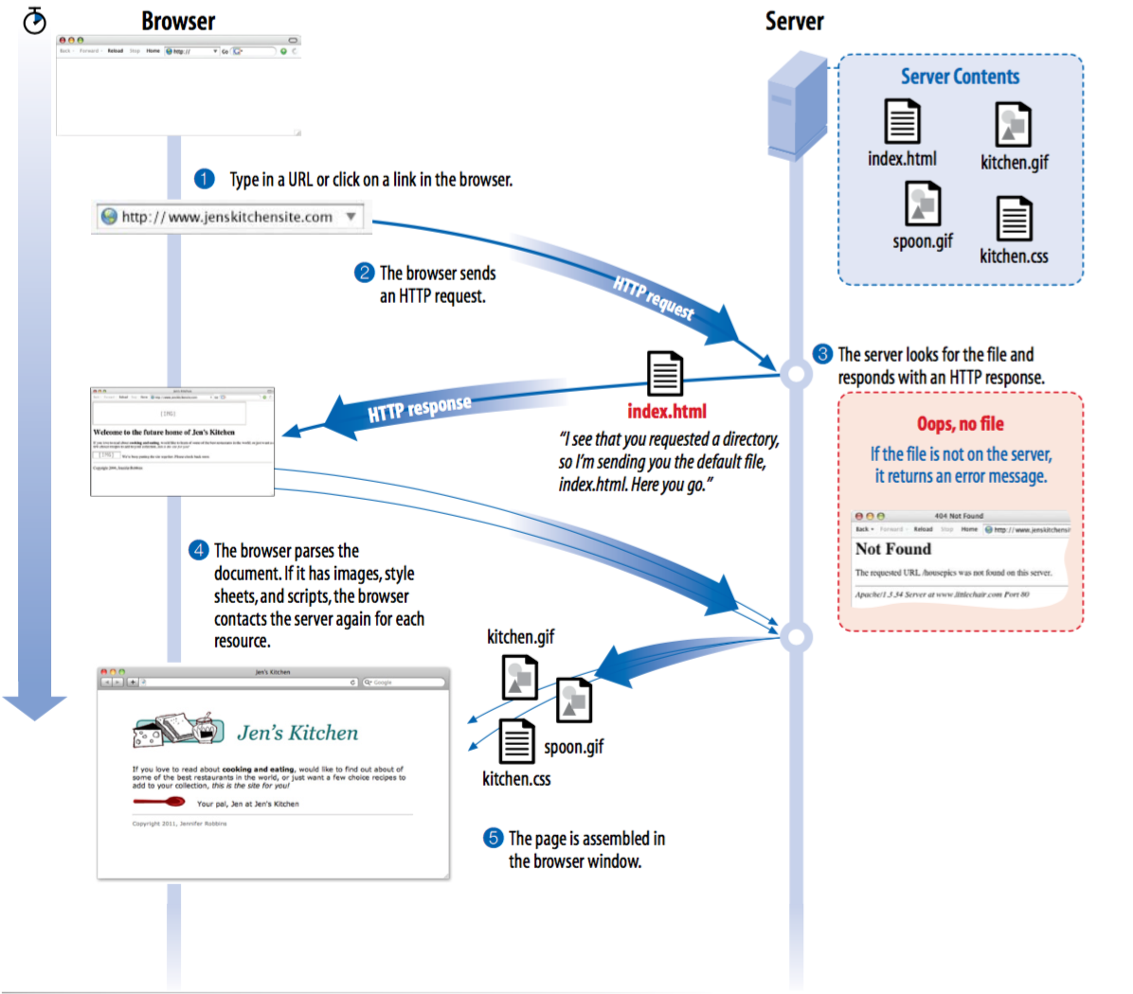
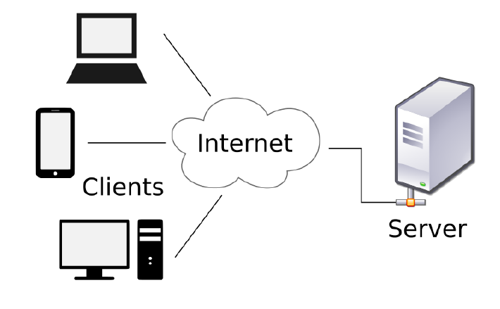
Overview

Slide 59
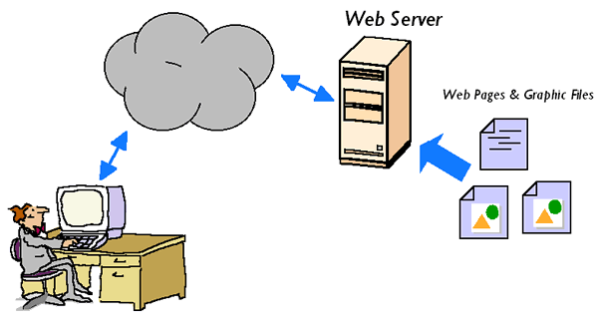
Web server
The server is the software (not the computer itself) that:
allows the computer to communicate with other computers
waits for a request for information, then retrieve and send that information back as quickly as possible
This software is installed In the actual computer, which is installed server operating system and called host
Notes:
What kind of other servers do you know?
(File server, Database server, Domain Name server, Mail server …)

Slide 60
Most popular web server
Apache: ​One of the most popular web server in the world developed by the Apache Software Foundation. Apache is an open source software which supports almost all operating systems including Linux, Unix, Windows, FreeBSD, Mac OS X and more
IIS (Internet Information Services) is a Microsoft product. This server has all the features just like apache. But it is not an open source and more over adding personal modules is not easy and modification becomes a little difficult job.

Slide 61
Server operation system
Server OS is an operating system specifically designed to run on servers, which are specialized computers that operate within a client/server architecture to serve request of client on the network
Type of Server OS:
Windows server (2000, 2003 R3, 2008…)
Unix (Red Hat)
Mac OS X Server
Some applications, which typically run on server
Web server
Database server
Mail server
DNS server

Slide 62
Some applications, which typically run on server
Web server: Hosts web pages. A web server is what makes the World Wide Web possible. Each website has one or more web servers.
Database server: Maintains and shares any form of database (organized collections of data with predefined properties that may be displayed in a table) over a network.
Mail server: Makes email communication possible in the same way that a post office makes snail mail communication possible
DNS: is a hierarchical decentralized naming system for computers, services, or other resources connected to the Internet or a private network

Slide 63

A Word About Browsers
State what a web browser can do?
Some popular web browser
Internet Explorer
Firefox
Safari
Opera
Chrome
Notes:
Ask students to discuss
Static web page
Dynamic web page: multimedia
Play game
Programming
Word/Excel/Powerpoint editor
Email
Manage database
Graphical design

Slide 64
Static web
Static web
Made with HTML
Pages of text and graphics with hyperlinks to navigate from one to another
Limitations
Difficult to maintain.
Updated manually.
Inconsistency.
Don’t allow any user interaction.
The results didn’t meet the needs of each user with dynamically changing content

Slide 65
Dynamic web
Dynamic web
Allows customizing the content and its appearance in the browser.
Generates content “on-demand”.
Accepts the user inputs through web browser.
Several technologies evolved to make web sites more flexible and dynamic.
Variety device such as PDAs, Cell phones, and so on is used XHTML Documents

Slide 66
Static & Dynamic website

Slide 67
Web application architecture

Slide 68
Server-side Scripting Language
Dynamic web server are often created with server-side languages
Examples: Perl, PHP, Ruby, etc
They use Common Gateway Interface (CGI) to produce dynamic web pages

Slide 69
Client-side scripting language
Client-side scripting is changing interface behaviors within a specific web page
In response to mouse or keyboard action, or at specified timing events
The dynamic behavior occurs within the presentation
The client-side content is generated on the user’s local computer system

Slide 70
Server-side dynamic web page
It is a web page whose construction is controlled by an application server processing
In server-side scripting
Parameters determine how the assembly of every new web page proceeds
Including setting up of more client-side processing
Why do we need scripting language for the server side?
HTML is for displaying purpose only
It’s not capable of complicated business processing (accessing to files, database, network, etc.) -> why not? -> Security.

Slide 71
Server-side dynamic web page with PHP
Accessing this page at different time you will have different result

Slide 72
Client-side dynamic web page
It processes the web page using HTML scripting running in the browser
Client scripting language (e.g., JavaScript) determine the way HTML in the received page is parsed into the Document Object Model (DOM)
DOM represent the loaded page
The client-side techniques can dynamically update or change the DOM

Slide 73
Client-side dynamic web page with JavaScript

Slide 74
Some server-side scripting technologies
PHP: usually be used to develop web application, which can run on Apache server. But now, IIS also supports PHP. Web applications developed by php languages includes files in .php extension
ASP.Net: developed by Microsoft. This technology uses .aspx files to work with applications written by C# or Visual Basic language, which can be run on IIS server.
Pearl: developed for text processing in command line mode of UNIX and for web development. Perl uses .pl files
JSP: Needs more server application called Tomcat Server, is open source software developed by Apache Software Foundation. The web pages are written in .jsp extension files and almost work with servlets written by Java language.

Slide 75
Database server
My SQL: A popular open source database server, support almost popular operating systems
Oracle: A popular huge database server developed by Oracle. There are versions for almost popular operating systems.
DB2: This is database server product of IBM, supports various operating systems.
Microsoft SQL Server: Database server produced by Microsoft, only can runs on Windows OS

Slide 76
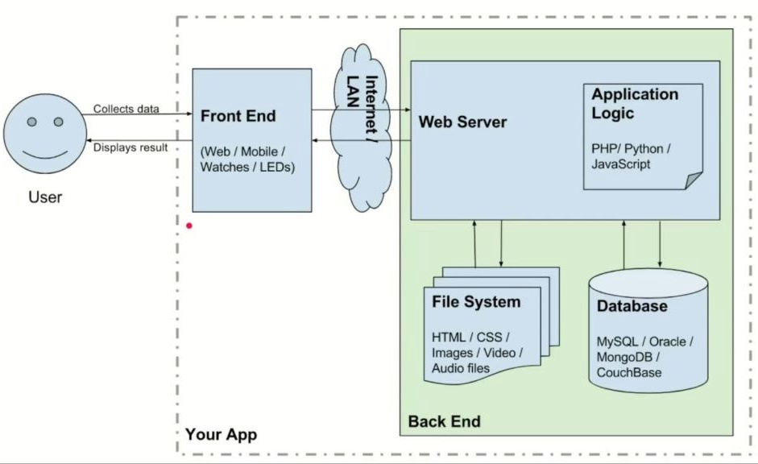
Front End And Back End

Slide 77
Tools and Technologies to create Web Application

Slide 78
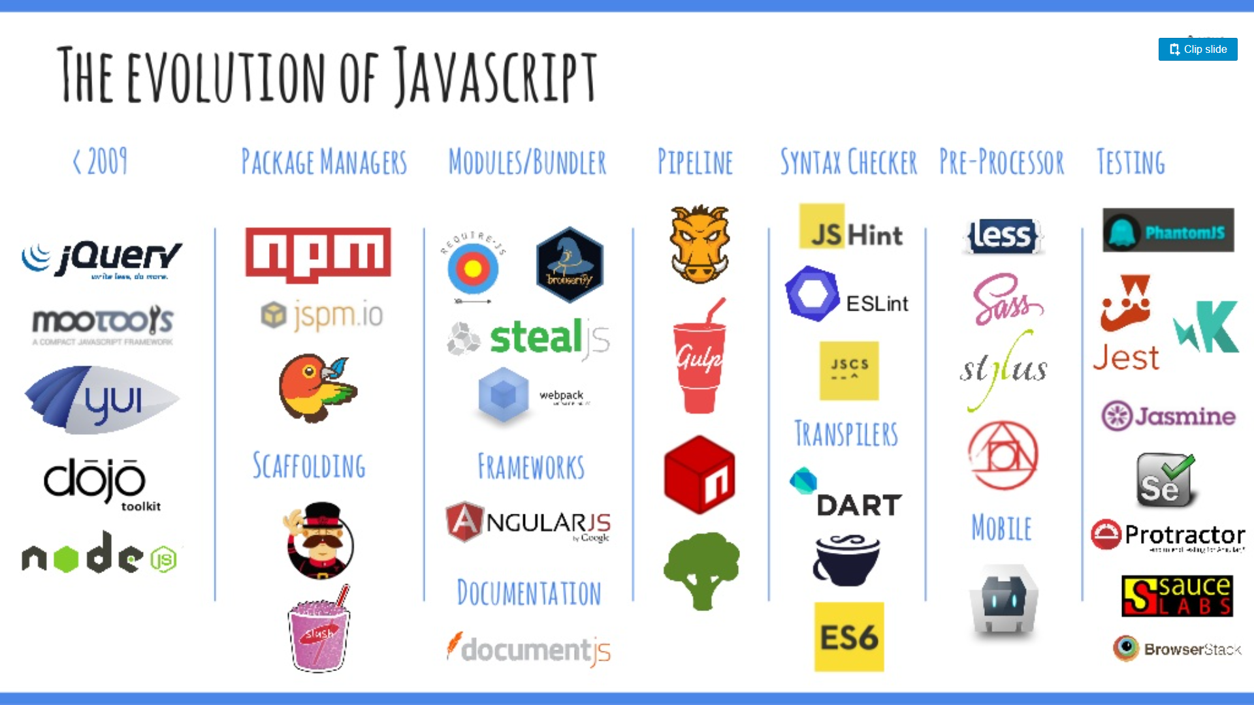
Front End Technologies

Slide 79
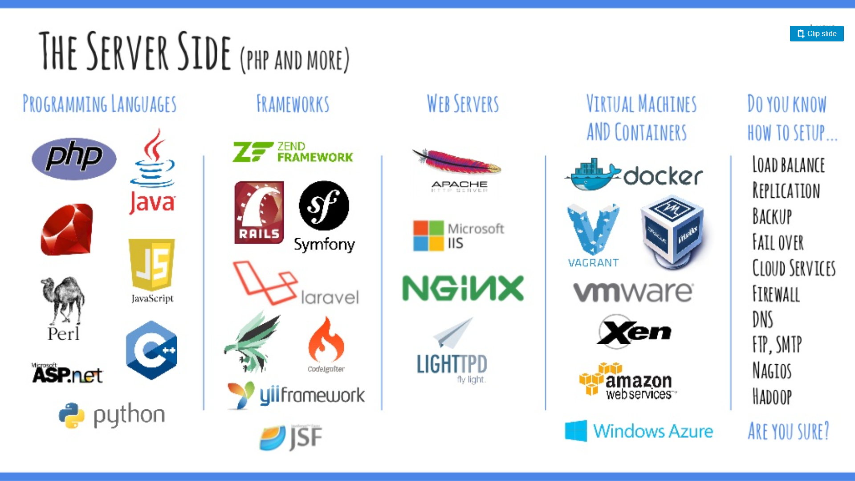
Back End Technologies

Slide 80
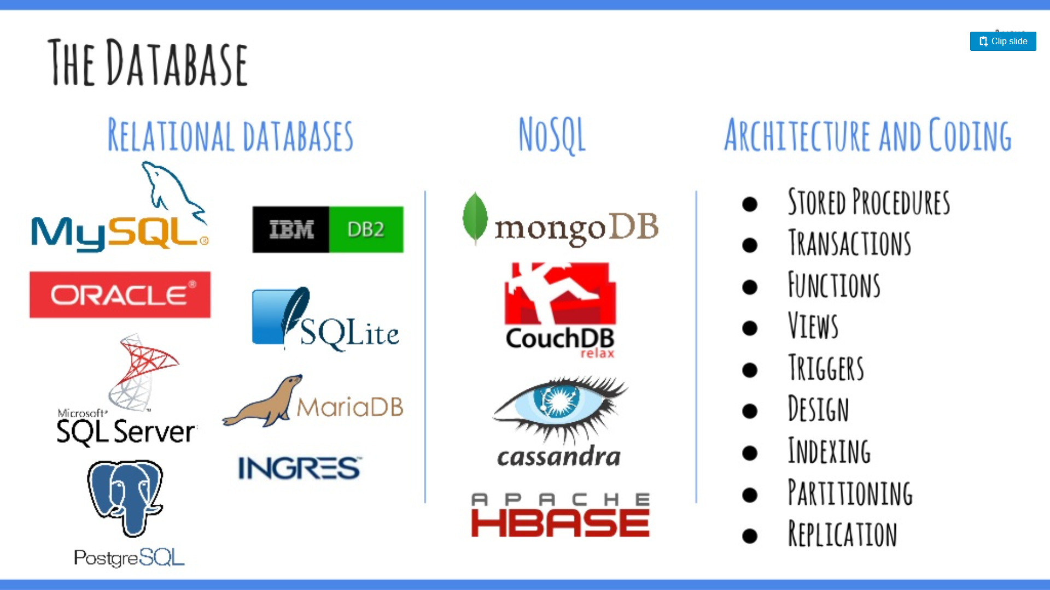
Databases

Slide 81











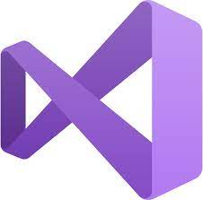

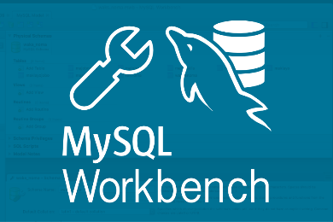

IDEs

Slide 82
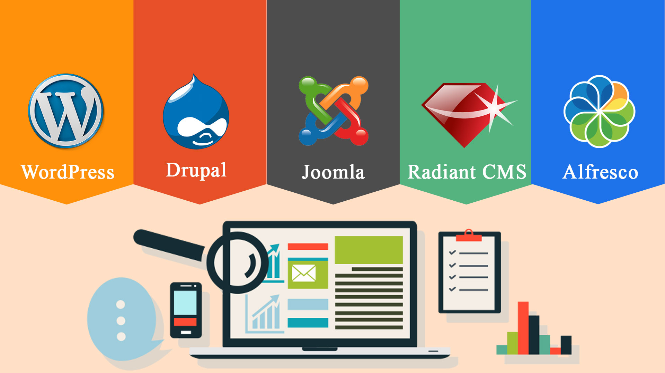
CMS

Slide 83
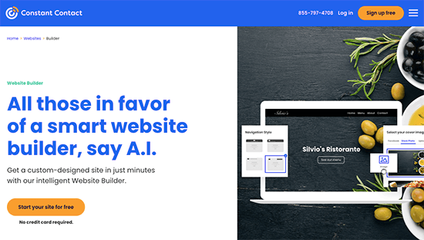

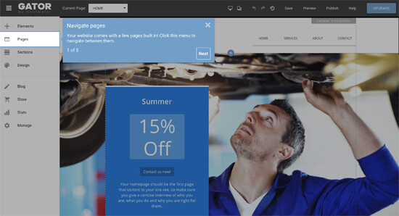

Website builder

Slide 84
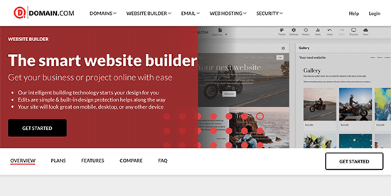




Website builder

